Slide 1

NLP to predict the market

Slide 2
Introduction
-can never truly predict stock market based on numbers alone
-however there is merit in analyzing how people’s opinions and feelings may affect it
-best method to do this is natural language processing

Slide 3
Motivation
-while not working with data in my every day job, i do work in the banking sector
-banking goes hand to hand with finance
-any hot finance topic is usually related to the stock market

Slide 4
Dow Jones Industrial Average
-a price weighted benchmark index for american blue chip stocks
-tracks 30 companies on the NYSE and NASDAQ

Slide 5
Dataset
-found on kaggle
-from 2008-2016
-contains major headlines and DJIA metrics(open price, close price, volume,etc)
-also had a label which had to be modified.(0 for decrease in price, 1 for increase)
Part 2:
-basic webscraping on finviz website

Slide 6
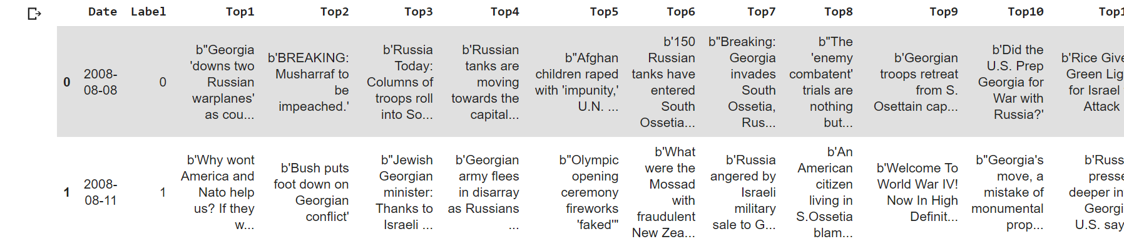
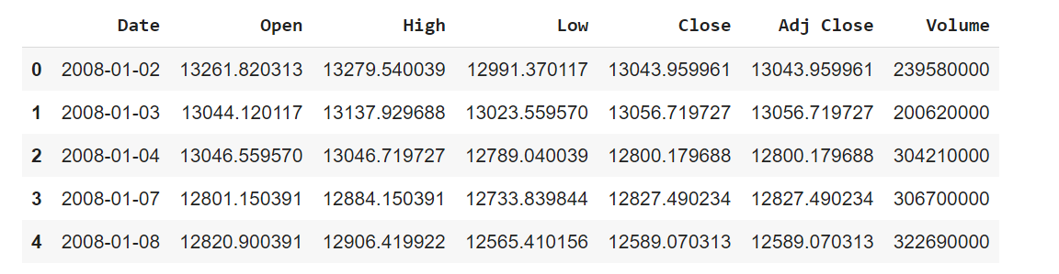

Slide 7
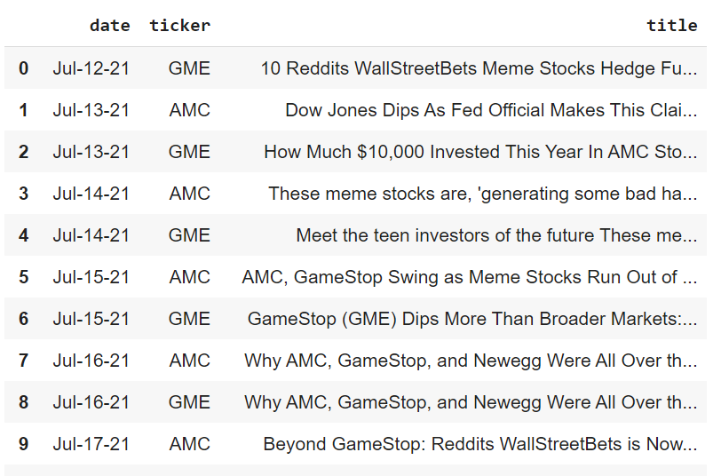

Slide 8
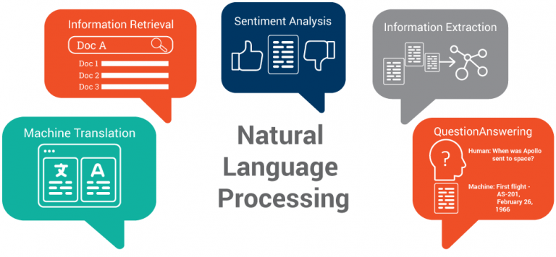
NLP
-tokenization
-frequency distribution
-stemming
-lemmatization
-stop word identification
-part of speech tagging

Slide 9
Vader
-valence aware dictionary for sentiment reasoning.
-polarity: whether a text’s sentiment is pos, neut, or neg
-compound: calculated by normalizing pos neut and neg scores
-dictionary containing words and phrases with rated polarity by independent human reviewers
-normalization: x = x/sqrt(x^2+alpha) where x is sum of valence scores and alpha is a constant at 15.

Slide 10
Transformers
-pre training with extracted gap sentences for abstractive summarization
-pegasus for financial documents/news/articles
-encodes,decodes, model act func, dropout; as we saw in class pretty much removes alot of the work
-similar to what we’ve seen; some sentences are MASK, pegasus is trained to predict.
-input for pretraining is document with missing sentences, output is missing sentences being woven together

Slide 11
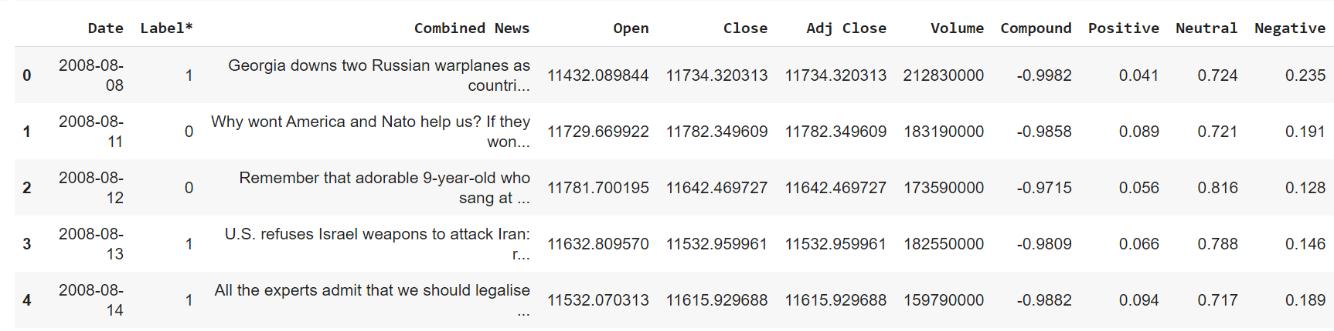
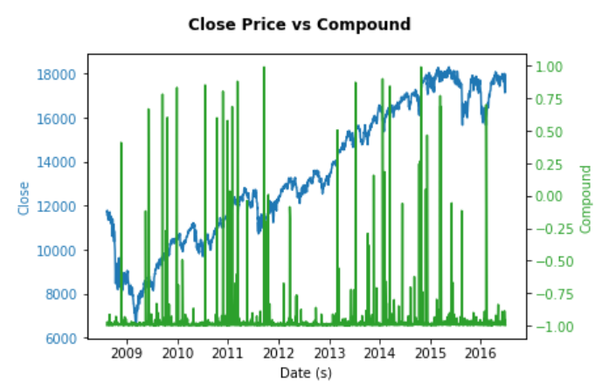

Slide 12
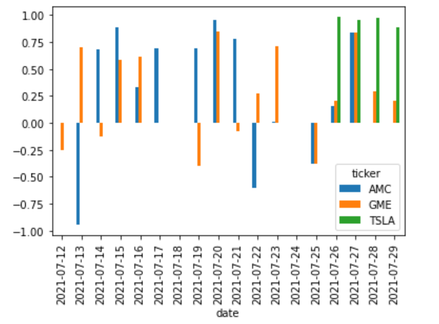
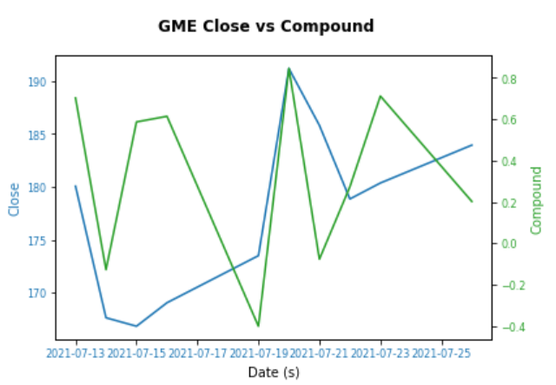
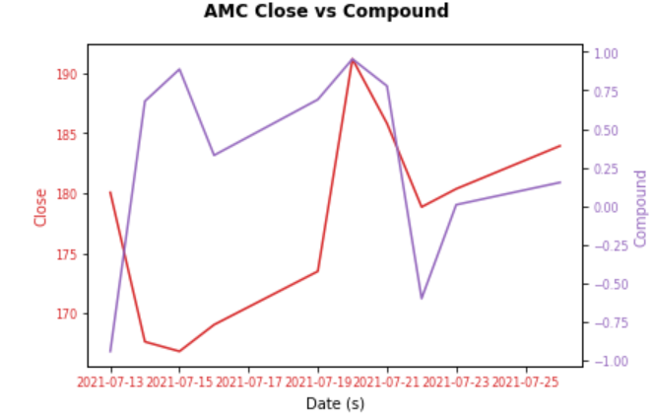

Slide 13
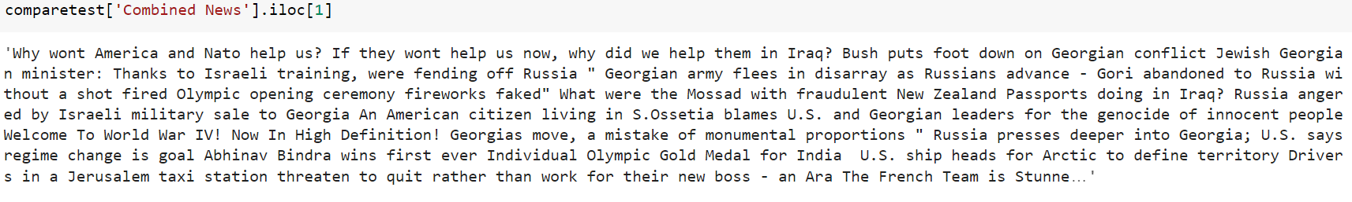
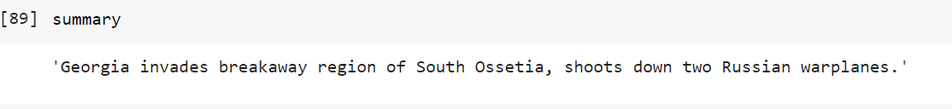

Slide 14
Model for Predictions
-following models: linear discriminant analysis, svm, sgdclassifier, random forest classifier

Slide 15
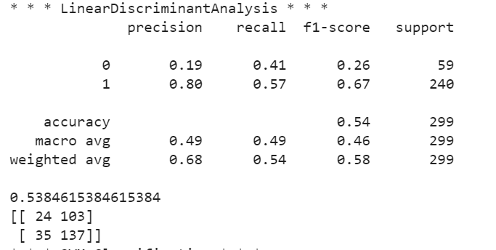
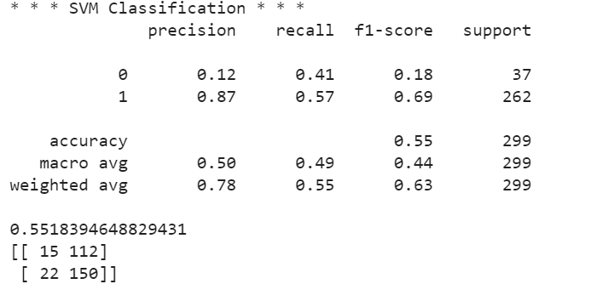
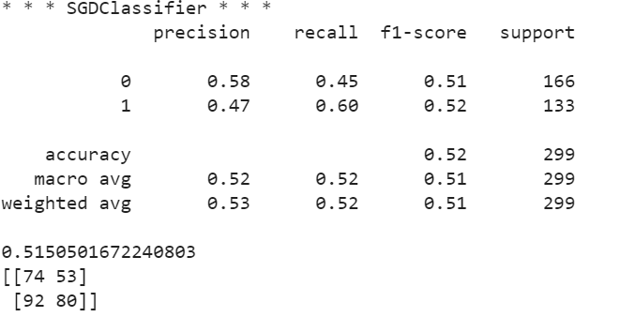
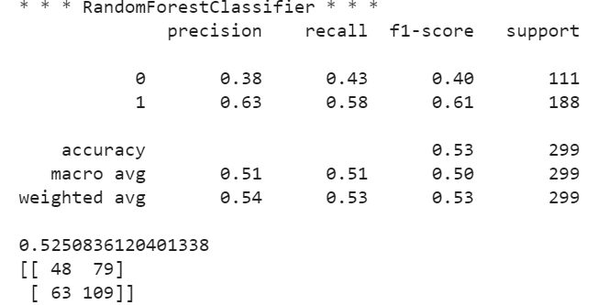

Slide 16
What was learned and what can be improved
-various nlp tools: how powerful,useful, and time efficient they are
-webscraping
-improvements: more recent data; obtain twitter and/or reddit api key to accomplish that

